Slide 1

CEIR Deployment Overview - Training Manual

Slide 2

Deployment Overview
About CEIR
Deployment Architecture
Integration Touch Points
Software Architecture

Slide 3
Product Overview
Key objective and functionality of CEIR is to block (or maintain black listing for blocking and grey listing for monitoring) the devices in multi operator’s environment homogeneously without any preference or selection for multiple reasons or objectives from using the network services like voice,SMS, GSMd data(not Wi-Fi data).
CEIR systems are also used for synchronizing the multiple EIRs from multiple network Operators in a country.
The only basis of blocking the device is IMEI / ESN / MEID of the device
There are scenarios where a local EIR in Operator’s environment or Central EIR at CEIR authority can take precedence to execute or trigger the user data collection and barring action. It is completely a case depends on country, regulation and law.

Slide 4


Product – Architecture
Manufacturer
Industry/
Importers
Customs
Retailer/Distributor
End User
(Local/Expat/Foreigner)
Law Agency/Immigration/TRC/Operator
TAC
Allocation Process
HTTPS
CEIR (Hosted in DMC IT Network)
SMS‘s Network
Secured API
Web Client
SMS I/F
DB
HTTP
Set of Process(One set of each User Type)
Secure
HTTP
Interface
Set of GSMA
Process
DB
Set of
Operator Process
HTTPs/FTP
Interface
…
Operator ‘s Network
DB
DB
HTTPs
FTP/HTTPs
Device Physical Flow
Device Physical Flow

Slide 5





Product – Integration
Email Server
CEIR System
SMTP
Operator IT Network
DMC IT Network
HTTPS
HTTP
Customer Care
SMS Server
MSC /SGSN
Server
Agent-based Interface
PRTG Server
Public Network
HTTPs
HTTPS
HTTPS
Payment GW
Users*
HTTPS
FTP
GSMA
Mediation
Server
Collector
Server
OTA Server
Users*: Importers, Customs, Police, Dealer, NID Register, Immigration Department, TRC, Company Registration Department

Slide 6
Product – Integration
ETL for Operator CDR via FTP
Bulk Aggregator for sending SMS
Email Server for sending e-mails
PRTG for alerts
GSMA over HTTP(s) for blacklist/TAC details
Payment Gateway for Device Activation Fee over HTTPs

Slide 7
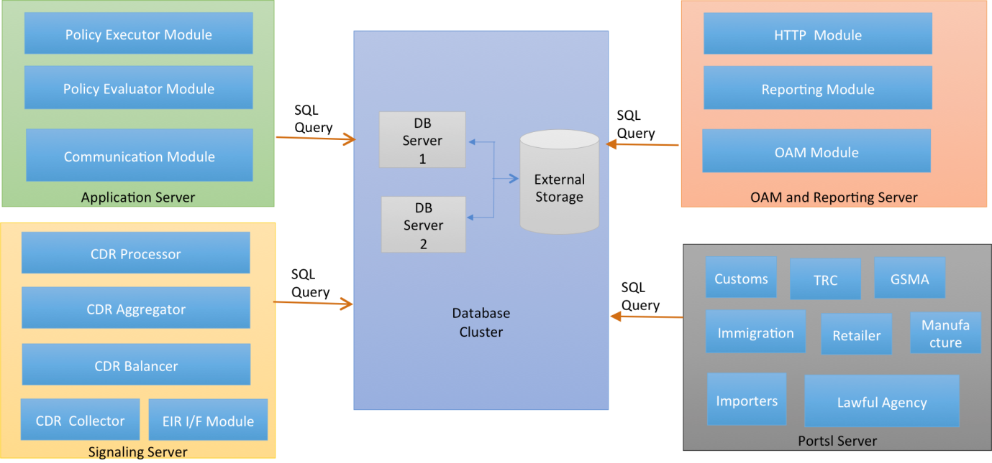
Deployment Architecture

Slide 8

Redundancy Architecture
Single IP between two servers called virtual IP
Each server has physical IP
Virtual IP is managed by Heart beat layer
Active / Standby Configuration
Virtual IP is on the active server
Heart Beat Layer

Slide 9
Software System Architecture
Front End Subsystem Architecture
System Sub System Architecture
Database Architecture

Slide 10
Software Architecture – Front End Sub System
Tomcat
API Sub System
1
User Interface
Sub System
DMC IT Network
HTTPs (80)
HTTPS
DB
SQL
API Sub System
2
HTTPS
HTTPS
SQL
User Group
Public Network
HTTPS(8)
SQL
HTTPS
API Sub System
N

Slide 11
Software Architecture – Front End Sub System
Tomcat is open source software providing HTTPS connectivity
Front End Sub System consist of 2 key modules:
User Interface Subsystem
Host the Complete Look and Feel of the System.
UI/UX
API Interface Subsystem
Host the business logic
Interaction with Database is with module only
3-tier architecture

Slide 12
Software Architecture – API Sub System
API Interface Subsystem
Implement Service that is consumed by other API interface sub system or User interface subsystem
All features as listed below are implemented
Registration
Consignment
Stock
Block/Unblock
Stolen/Recovery
Grievance
TAC
GSMA Blacklist

Slide 13
Physical Architecture – Front end Sub System
Client | Server | Port (TCP)
User Browser | User Interface Sub System | 80
User Interface Sub System | API Subsystem 1 | 9000
User Interface Sub System | API Subsystem 2 | 9010
User Interface Sub System | API Subsystem 3 | 9020
User Interface Sub System | API Subsystem 4 | 9030
API Subsystem N | Database | 3306

Slide 14
Deployment - User
Three kind of users
Application user where the application is installed
ceirapp
/home/ceirapp
FTP user where the file is uploaded by ETL
ftpuser
/opt/ftp/ETL
Database user to connect to the Database
ceirapp

Slide 15
Process Management
Name of the process which comes when ps –ef command Is executed
Sub System | Name | Path
Tomcat | Tomcat-ddd. | /home/ceirapp/tomcat/
User Interface Sub System | Not Required as started along with tomcat | /home/ceirapp/tomcat/apps/
API Subsystem 1 | api-ss1 | /home/ceirapp/api-ss1/
API Subsystem 2 | api-ss2 | /home/ceirapp/api-ss2/
API Subsystem 3 | api-ss3 | /home/ceirapp/api-ss3/
API Subsystem 4 | api-ss4 | /home/ceirapp/api-ss4/

Slide 16
Software Management
Scripts to start/stop/status check for each sub system
Sub System | Start Script | Stop Script | Status Script
Tomcat | tomcat.sh start | tomcat.sh stop | tomcat.sh status
User Interface Sub System | Not Required as started along with tomcat | Not Required as started along with tomcat | Not Required as started along with tomcat
API Subsystem 1 | api-ss1.sh start | api-ss1.sh stop | api-ss1.sh status
API Subsystem 2 | api-ss2.sh start | api-ss2.sh stop | api-ss2.sh status
API Subsystem 3 | api-ss3.sh start | api-ss3.sh stop | api-ss3.sh status
API Subsystem 4 | api-ss4.sh start | api-ss4.sh stop | api-ss4.sh status

Slide 17
Software Path Management -
Where the Software is installed.
Base Path
Application wise folder
Tomcat
Scripts ?
The script folder is a symbolic link to /var/prtg/scripts

Slide 18
Software Path Management -
Where the Software is installed.
Application Wise Folder
Application Binary
Logs
Config
The status script are configured at PRTG end
Each Application folder must contain
Application binary / Executable
Logs folder where logs are generated
Configuration File to configure the system
Start / Stop / Status scripts

Slide 19
Log Management
Each application has a logs folder
Logs folder is a soft symbolic link
The actual logs are created in the /opt/ceirapp/<application name>/logs

Slide 20
Release Management
All release are maintained in /opt/ceirapp/release/upload/<application_name> folder. – called as Software Release Folder
There is a folder for each application subsystem where backup to be maintained.
Release must contain the executable and configuration file
Under each application sub system, create a folder date wise (ddmmyy) and copy the backup of release in this folder.

Slide 21
Release upload
All release maintenance is happening in maintenance window
Stop the current release
Copy the new release in release folder first
Take the backup of existing release. The configuration file etc may have changed
Replace the existing release with the new one
Start the new release and test

Slide 22
Operations
DB connectivity details has changed
Server IP got changed
GSMA credential got changed
SMS credential got changed
All these changed can be done through web interface.

Slide 23
External Dependency
The software contain all the modules deployed on the server
All software and third party software are deployed on the server

Slide 24
Process Management - System
Name of the process which comes when ps –ef command Is executed
Sub System | Name | Path
SLA | sla_proc | /home/ceirapp/app/sla/
Close Grievance | Close_greivance_proc | /home/ceirapp/app/close_grievance/
Grey List File Generation process | Greylist_filegen_proc | /home/ceirapp/app/gl_filegen/
Black List DB Generation Process | Blacklist_dbgen_proc | /home/ceirapp/app/bl_dbgen/
Black List File Generation process | Blacklist_filegen_proc | /home/ceirapp/app/bl_filegen/
Expired Visa Process | Expired_visa_proc | /home/ceirapp/app/exp_visa

Slide 25
Process Management - System
Name of the process which comes when ps –ef command Is executed
Sub System | Name | Path
Reminder Process | reminder_proc | /home/ceirapp/app/reminder/
Tax not paid Process | Tax_not_paid_proc | /home/ceirapp/app/tax_not_paid/
Invalid TAC Delete Process | Invalid_tac_delete_proc | /home/ceirapp/app/invalid_delete_tac/
GSMA Black List Delete Process | Gsma_blacklist_delete_proc | /home/ceirapp/app/gsma_blacklist_delete/
User Regularization Process | User_reg_proc | /home/ceirapp/app/user_reg/
User Regularization Expiry Process | User_reg_expiry_proc | /home/ceirapp/app/user_reg_expiry_proc

Slide 26
Process Management - System
Name of the process which comes when ps –ef command Is executed
Sub System | Name | Path
Import Valuation Process | Import_valuation_proc | /home/ceirapp/app/import_valuation/
Tax not paid Process | Tax_not_paid_proc | /home/ceirapp/app/tax_not_paid/
Invalid TAC Delete Process | Invalid_tac_delete_proc | /home/ceirapp/app/invalid_delete_tac/
GSMA Black List Delete Process | Gsma_blacklist_delete_proc | /home/ceirapp/app/gsma_blacklist_delete/
User Regularization Process | User_reg_proc | /home/ceirapp/app/user_reg/
User Regularization Expiry Process | User_reg_expiry_proc | /home/ceirapp/app/user_reg_expiry_proc

